Slide 1
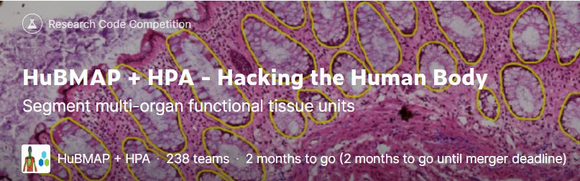
HuBMAP + HPA – Hacking the Human Body
Progress Meeting 5 Group A
https://www.kaggle.com/competitions/hubmap-organ-segmentation

Slide 2
01
Learning rate
CONTENTS
02
Larger tile+Resize
03
Further improvements

Slide 3
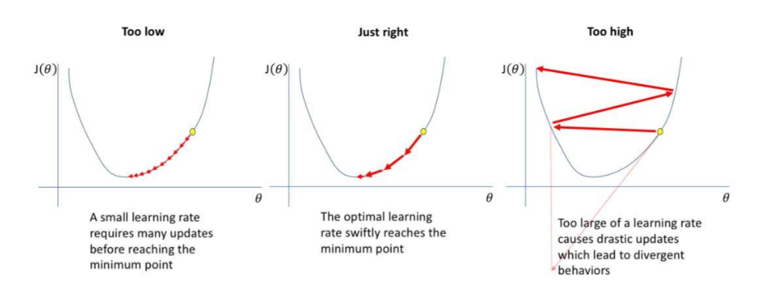
01
Learning rate
Learning rate is a trade-off between convergence and divergence.
If the learning rate is too small, the convergence is slow.
If the learning rate is too large, the loss will oscillate and even become larger.

Slide 4
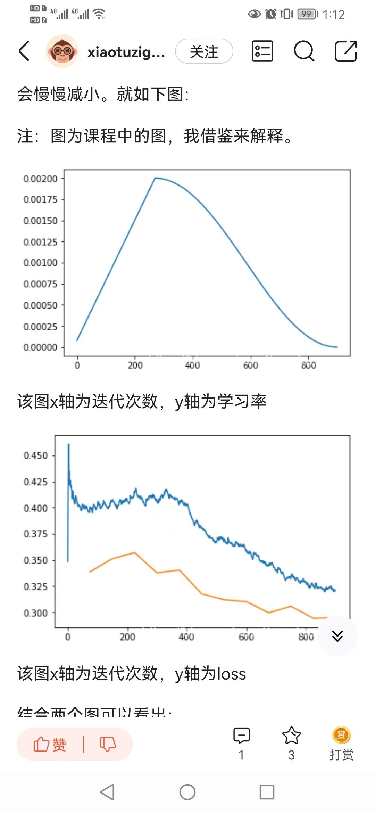
01
Learning rate
Learning rate annealing
First gradually increase the learning rate, and then gradually reduce the learning rate.
https://arxiv.org/abs/1608.03983

Slide 5
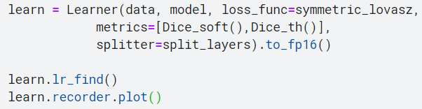
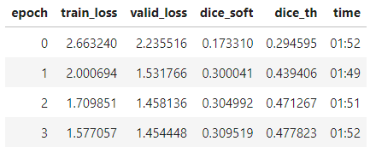
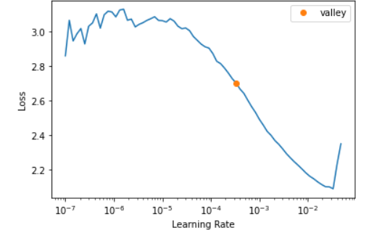
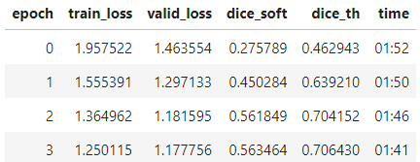
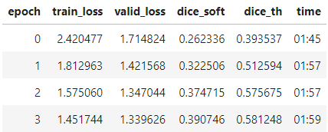
01
Learning rate
Stage1
LR =0.5e-3
LR =0.5e-2
LR =1e-3
https://blog.csdn.net/xiaotuzigaga/article/details/87880512
https://arxiv.org/abs/1506.01186

Slide 6
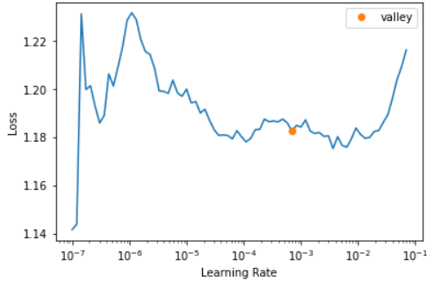
01
Learning rate
Stage2
How to find left value:
Look for the point of rise, then divide by 10
How to find the right value:
Reduce the value of the first stage by five to ten times
slice(left,right)
https://blog.csdn.net/xiaotuzigaga/article/details/87880512
https://arxiv.org/abs/1506.01186

Slide 7
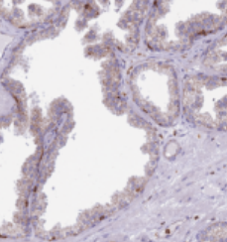
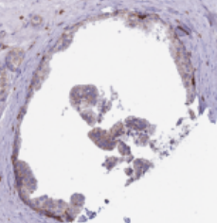
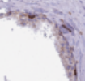
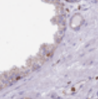
STRATEGY
QUICK REVIEW
As we mentioned in last presentation, small size tiles make the model confused.
However, large size tiles cause another problem: CUDA out of memory.
Therefore:
Divide the whole images into tiles with 512x512 size, then resize the 512x512 size tiles to 256x256 size.

Slide 8
STRATEGY
SCORE IMPROVEMENT
Resize the tile size from 512x512 to 256x256

Slide 9
STRATEGY
SCORE IMPROVEMENT
As mentioned by Group C in last presentation, we adopt the edge effect removal strategy.

Slide 10
STRATEGY
SCORE IMPROVEMENT
Using pre-trained model and new data augmentation strategy.

Slide 11
STRATEGY
FUTURE WORK
When the tile resizes from 512x512 to 256x256, a lot of pixel information will be lost. Fix the CUDA out of memory and train a new model by 512x512 size tiles.
Change the backbone of the network.
Deepen the network layers.

Slide 12
Thanks for listening

